Slide 1
GLOBAL POSITIONING SYSTEM (GPS)
Invented by the US Department of Defence
First used by the US Army (DoF)
In the 1980s the US DoD allowed civilians to use GPS
No subscription fee to use a GPS
A number of GPS types; Garmin (GPS II, III, V, 76), Trimble (Juno 3B, Juno 3D, Juno SB……..
GPS memory lasts long
It has a strong lithium battery

Slide 2
Examples of GPS Receivers
Garmin
Trimble (High sensitivity GPS receiver)

Slide 3
Juno 3 Series

Slide 4
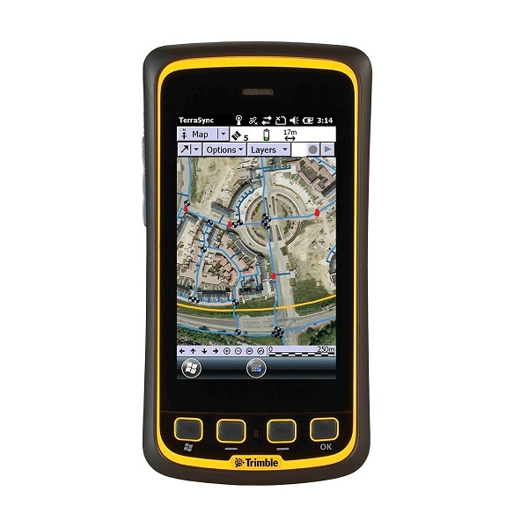
Juno 5 Series

Slide 5
SAFE HANDLING OF GPS RECEIVERS
Do not expose the machine to water
Do not place it near fire (Excessive heat)
Always press GPS buttons gently and carefully
Ensure that your fingers are clean before pressing the buttons
Avoid unnecessary dropping of the machine
Do not give it to unauthorized people
In case of mechanical problems do not open the machine, take it to authorised technician
Remove the batteries if GPS is not to be used for a long time
Always wear the GPS string when mapping

Slide 6
How does a
GPS work?

Slide 7
HOW IT WORKS
Communicates with satellites
Signals sent from satellites
Time difference between when signal was sent and when received by GPS is noted
GPS locates the place where you are standing (Triangulation method)
Easting, Northing and altitude on your GPS can now be recorded
GPS can now guide the user to get other pieces of information such as distance from destination, direction to take, Speed……

Slide 8
Satellites
Satellites are manufactured
Have a life time (10 yrs)
There are 24 GPS satellites that orbit the Earth surface twice in less than 24hrs
Powered by solar energy but with stand by batteries in case of a solar eclipse

Slide 9
RECEIVER INITIALISATION
Telling the GPS where you are
Different approaches for different machines

Slide 10
RECEIVER INITIALISATION; When?
When you have just acquired it from a shop
If the memory has been cleared

Slide 11
GPS Receiver Setting (GPS 76)
Switch on your GPS receiver
Click on menu twice
Main menu appears with a number of options
Use the lower button on the Rocker key pad and select setup, press enter button
On the main menu, select general, a number of options
For MODE select Normal, WAAS select off, Back light time out, eg 15 secs,

Slide 12
Set up-Contd
Under beeper, may select off, for language, select ENGLISH
Use the the button on the top of Rocker key pad to go back to main menu and select TIME
Now use the button on the bottom part of the Rocker key pad to move down
For time format choose 12 Hrs
For time zone choose OTHERS
For UTC off set choose +03:00
Current date: auto
Current time: auto

Slide 13
Set up-cont
Now go back to the main menu
Use the button on the right part of the Rocker key pad and select UNITS
Now explore the options under Units
For elevation choose meters
For depth select meters
For distance and speed choose metric
For temperature select Celsius

Slide 14
Set up contd
For direction display choose numeric degrees
Back to main Menu and select LOCATION
For location format, select UTM UPS
For map Datum select WGS 84
For north reference select Grid
Go to main Menu and high light INTERFACE
Go thru the options and select Garmin, Set up is now complete and yr GPS is ready for use

Slide 15
ERRORS IN COORDINATES
Poor training
Wrong settings
Bad weather
Poor hand writing
Poor condition of GPS receiver
Being in a hurry while taking coordinates
Using incapable surveyor to collect data
“Doctoring” coordinates
No punitive measures by MWE for those who submit wrong coordinates

